Slide 1



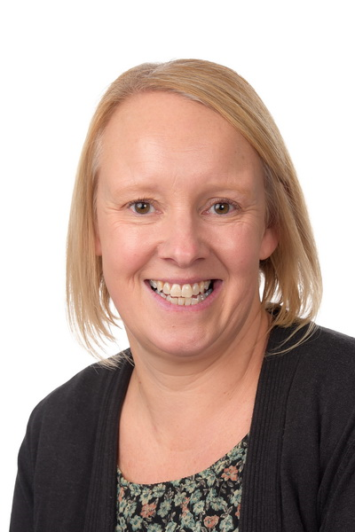
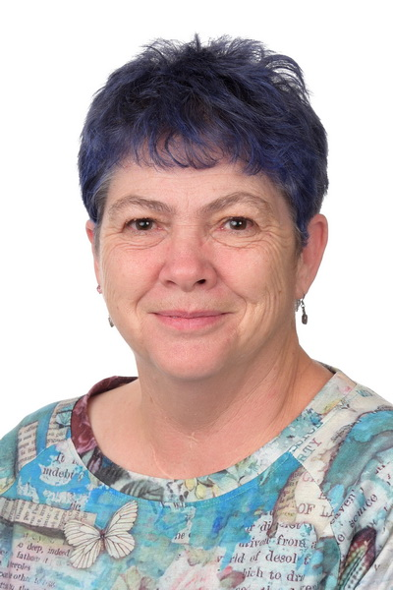
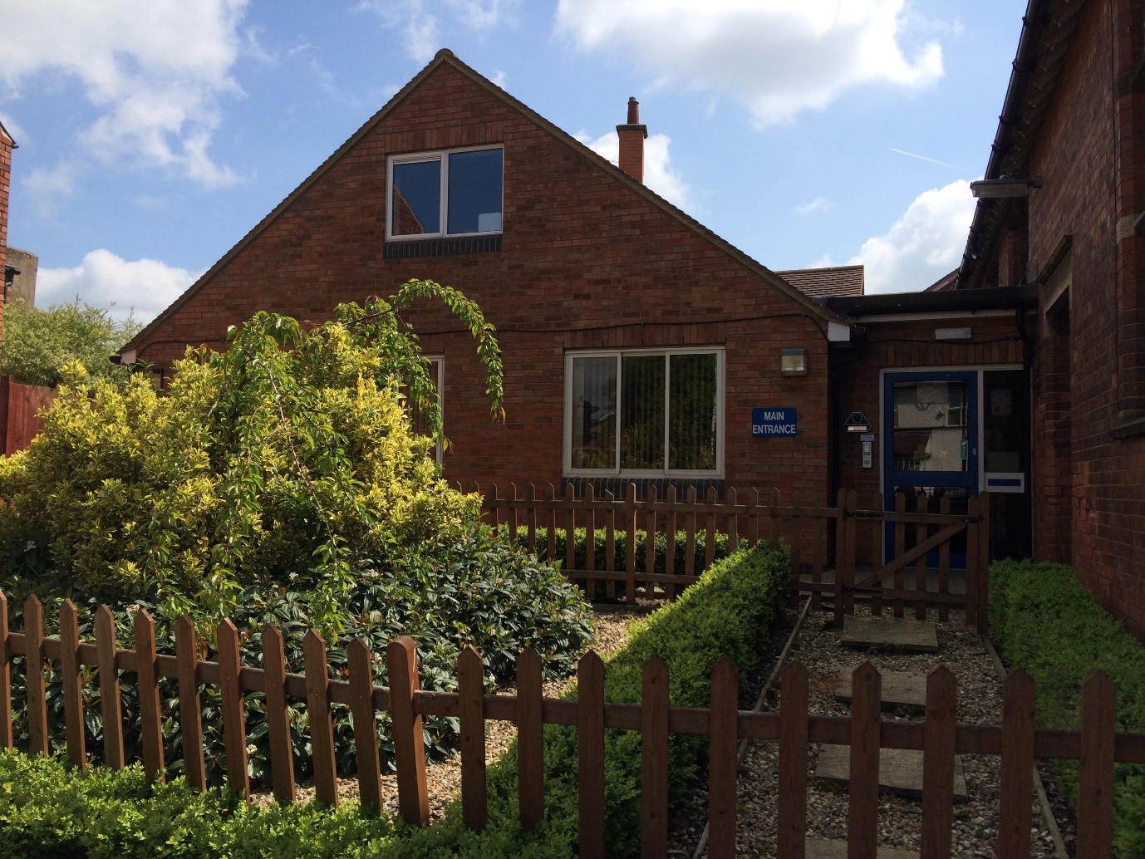
Safeguarding Statement
St Mary’s school is committed to safeguarding and promoting the welfare of children and requires all staff, volunteers and visitors to share this commitment.
Printed copies of our Safeguarding Policy, policy in relation to Allegations/Concerns in relations to adults and Whistleblowing Policy are in our staff room. For more information on these and all our policies please visit our website: stmaryscebl.info
Visitors & Volunteers Procedures
All visitors/approved volunteers MUST sign in via the electronic SignIn App system at the Reception on arrival on the School site. All visitors/volunteers must sign out at the Reception before leaving the site.
All visitors/volunteers will be issued with a visitor lanyard which must be displayed at all times whilst on our premises.
Visitors/volunteers without a DBS clearance will be asked to remain under the supervision of a designated member of staff at all times whilst on site.
Visitors/volunteers wishing to see a particular member of staff should contact the school to make an appointment. If you are seeking an urgent appointment, please report to Reception and we will arrange for you to see a member of staff.
E-SAFETY
Never share personal information such as telephone numbers, email addresses or social media contacts with a child. If a child tries to share their details with you, inform the class teacher as soon as possible.
Photographs – under no circumstances should you take photographs or videos of our children whilst at our school.
Mobile phones – please do not have your phone out or use it during your time in our school. If this is an issue, please speak to a member of staff on arrival.
SAFEGUARDING TEAM
If you have any concerns or questions whilst on site please contact one of the following members of staff.
WELCOME TO ST MARY’S
SAFETY INFORMATION FOR VISITORS & VOLUNTEERS
Mrs Sarah Reynolds
Headteacher
Designated Safeguarding Lead
Mrs Cara Bolton
SENDCo/
Deputy Head
Deputy Designated Safeguarding Lead
This leaflet provides you with important information to keep you safe and also vital information on our procedures that you are expected to adhere to while on our premises in order to keep children in our school safe. Please take a few minutes to read through this and familiarise yourself with its contents and keep this booklet with you all all times so you can refer to it as and when necessary.
Mrs Emma Campbell
Learning Mentor Deputy Designated Safeguarding Lead
Mrs Tracy Molsher
Family Support Worker
Deputy Designated Safeguarding Lead
To contact the local authority Designated Officer for North Northamptonshire, please call Sheila Kempster on 07831 123193 or 01604 362993. Alternatively please email your query to LADOConsultations@nctrust.co.uk and a Designated Officer will get back to you as soon as they are able to.
DREAM, BELIEVE, ACHIEVE

Slide 2
What to do if you are worried about a child
What to do if you are concerned about the conduct of an adult during your visit
Health & Safety
If you become concerned about:
Something a child says
Marks or bruising on a child
Changes in a child’s behaviour or demeanour
Fire
Immediately inform the Headteacher – Mrs Sarah Reynolds
In their absence, immediately inform a member of the Senior Leadership Team.
If your concern is about the Headteacher – please contact PDET on hr@pdet.org.uk
Do not smoke or vape anywhere on site – including the grounds as well as the buildings.
In the event of a fire alarm, please use the nearest fire exit and make yourself known to a member of staff. Please make yourself aware of the nearest fire exit to where you are based. If you are disabled and feel you may require assistance during an evacuation of the building, please advise reception staff on signing in.
please report these concerns to the school’s Designated Safeguarding Lead (DSL) or if not available the Deputy Designated Safeguarding Leads (DDSL) – see overleaf for their details. Alternatively, write your concerns on one of our yellow ‘Recording Form for Safeguarding Concerns’ forms which you can find in the staff room and in the school office and pass to the DSL/DDSL. We understand that sometimes people are unsure whether they should report something or not. Our advice would always be that if something makes you feel uncomfortable, then speak to our DSL/DDSL and record your observations. Children may be abused regardless of gender, culture, religion, social background and those with or without a disability.
Visitors Code of Conduct
Accidents & Illness
All accidents, regardless of severity, needs to be reported to a first aider. Staff will inform you of the first aider nearest to where you are based. Accidents will be logged (on SmartLog) and the Headteacher informed.
If you are feeling seriously ill when on your visit to
school, please report to a First Aider. We have two defibrillators on site.
Sign into school when you arrive, sign out when you leave and wear your identification badge at all times, ensuring it is visible.
Treat everyone with respect
Act as a positive role model at all times and provide an example you would wish others to follow.
Remember someone else may misinterpret your actions no matter how well intended.
Do not jump to conclusions without checking.
Do not permit abusive activities such as bullying or ridiculing.
Avoid physical contact with children unless you are preventing them from immediately harming themselves or others.
Avoid any situation where you are working alone with a child, out of sight of school staff.
Do not make suggestive remarks, gestures, or tell sexists or homophobic jokes.
It’s best not to do anything for a child that he or she can do for themselves.
Always tell the DSL/DDSL if a child touches you or speaks to you inappropriately.
Inform a teacher of any inappropriate behaviour.
Keep all information confidential.
What to do if a child discloses that they are being harmed
Whilst this can be an alarming situation, it is important that you know what to do in such an eventuality and for you to stay calm and controlled. You should:
Comfort/rest breaks
Listen carefully to the child, particularly what is said spontaneously.
Do not show shock or disbelief.
Do not promise confidentiality. Reassure the child but do not make promises that might not be possible to keep.
Reassure the child that you will tell the Headteacher who will be able to help them.
Do not interrogate or ask leading questions.
Reassure the child it is not their fault; stress that it was right to tell.
Record carefully what the child says in their words including how and when the account was given. Also record the date and time and sign the record. Pass this to the DLS/DDSL.
Be aware of your feelings about abuse and find someone to share your feelings with once the procedures have been completed.
Should you require a comfort/rest break during your visit, a member of staff will happily direct you to our staffroom where you can access tea and coffee-making facilities or signpost you to adult toilet facilities.
Pupil Behaviour
During your visit you might observe a pupil struggling to manage their behaviour. We would like to reassure you that staff have been trained to manage these situations keeping the child, themselves and others safe. You can help by moving away. Please be aware that a member of staff may ask you to leave the room until the situation has calmed.

